Slide 1
National initiatives: giving audits leverage
An overview of the situation in various countries
Robin Barkhausen, Fraunhofer ISI
22/11/2022
The responsibility for the information and the views set out in this presentation lies entirely with the authors. The European Commission is not responsible for any use that may be made of the information it contains.

Slide 2
Presenter: Robin Barkhausen
Researcher and PhD student Fraunhofer Institute for Systems and Innovation Research (ISI) Karlsruhe [DE] Work areas: Energy efficiency, decarbonisation of industry, Ecodesign, circular economy
Contact
robin.barkhausen@isi.fraunhofer.de

Slide 3
Energy Audit obligation according to Article 8 Energy Efficiency Directive (EED)
‘energy efficiency’ means the ratio of output of performance, service, goods or energy, to input of energy
Article 8: Energy audits and energy management systems
(4) Member States shall ensure that enterprises that are not small-to-medium sized enterprises (SMEs) are subject to an energy audit [...] by 5 December 2015 and at least every four years from the date of the previous energy audit.
(6) Enterprises [...] that are implementing an EMS [...] shall be exempted.
25.10.2012 Directive 2012/27/EU on energy efficiency
Company category | Staff headcount | Turnover or | Balance sheet total
SME | <250 | <= € 50 m | <= € 43 m
Link to EED: https://eur-lex.europa.eu/legal-content/EN/TXT/PDF/?uri=CELEX:02012L0027-20200101&from=EN

Slide 4
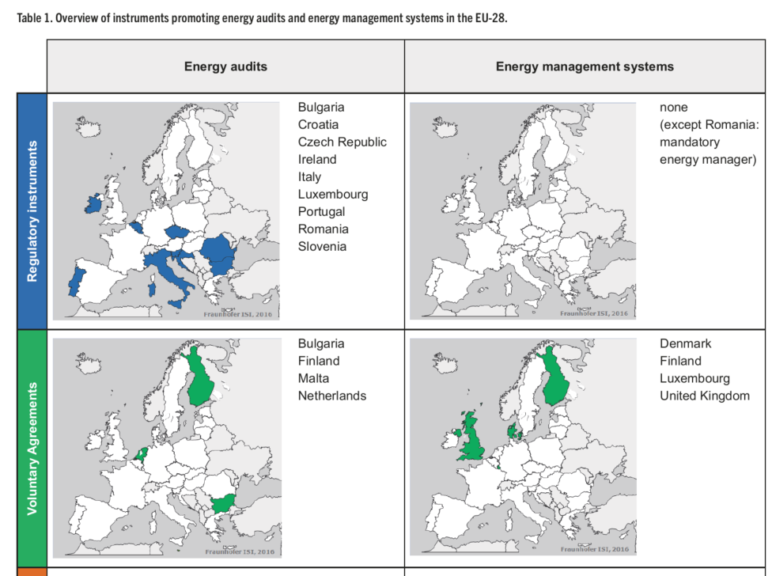
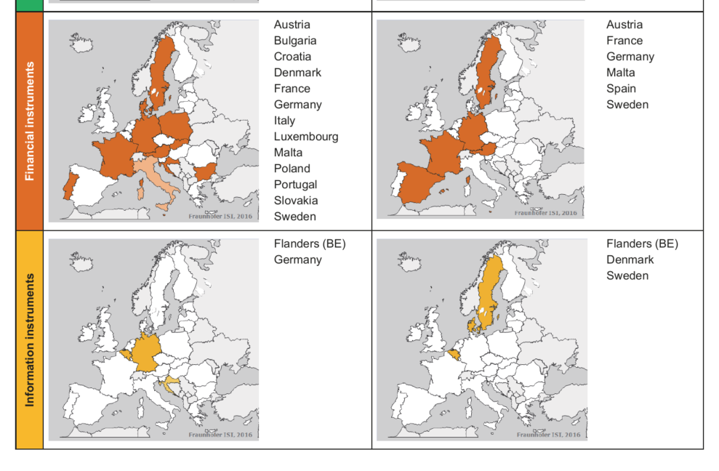
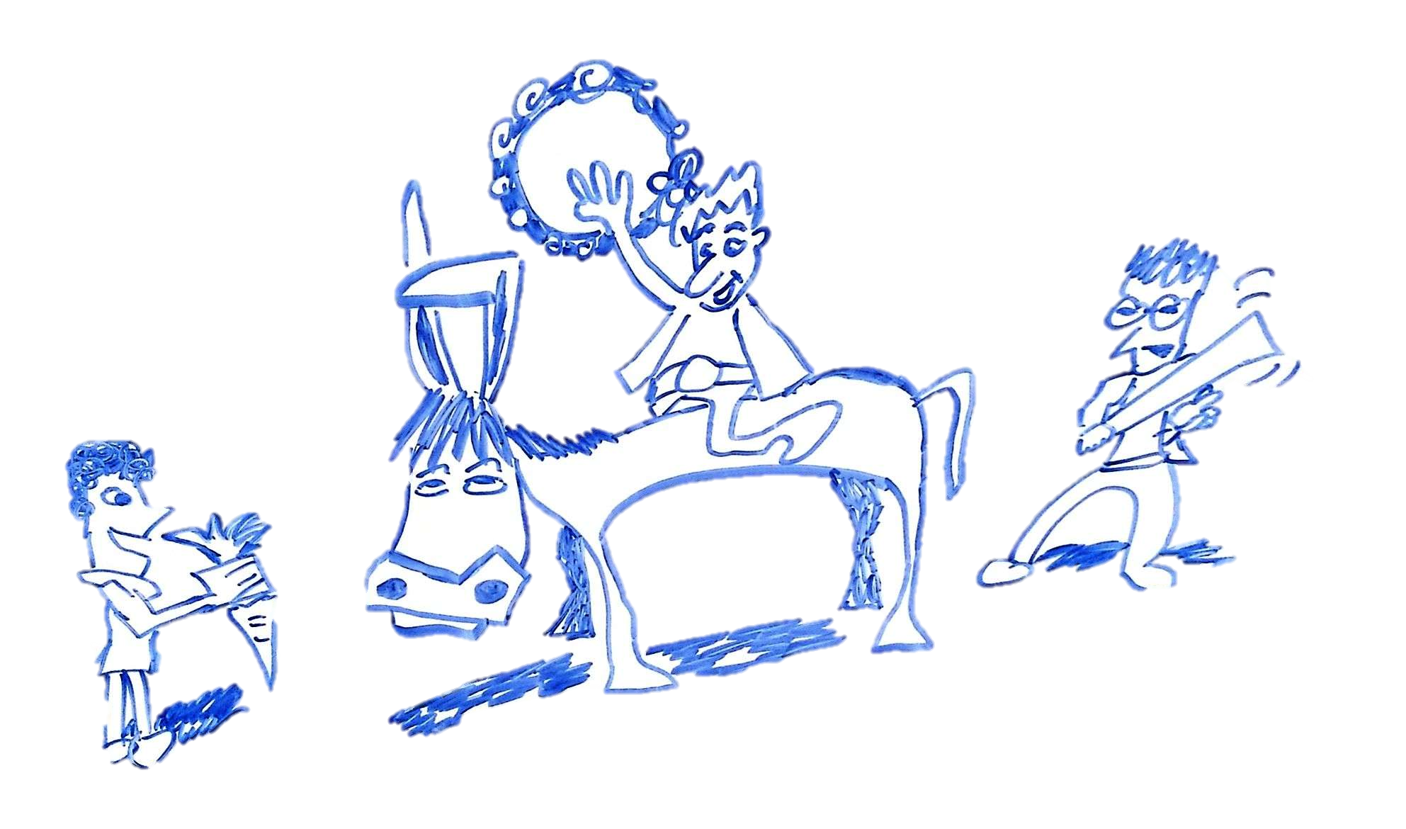
Extremely diverse policy landscape in the EU
Nabitz et al. (2016): How can energy audits and energy management be promoted amongst SMEs? A review of policy instruments in the EU-28 and beyond

Slide 5
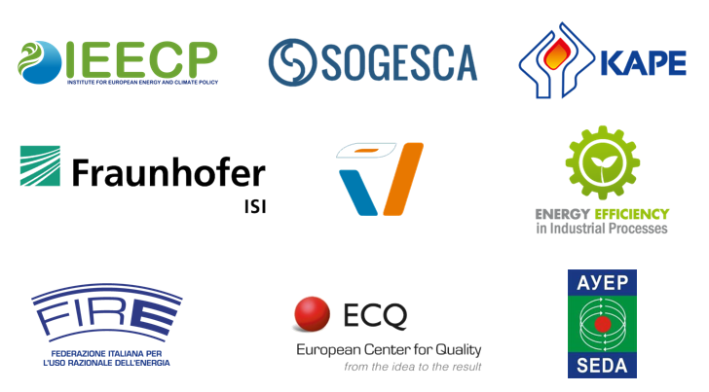
Information about the DEESME project
GOAL | PARTNERS | TIME
Enabling companies to manage their energy transition by taking profit of multiple benefits from EMS and energy audits Provide national authorities with guidelines and recommendations to empower their schemes under Art. 8 | Consortium of academics, research organisations, consultancies and government offices Project partners from Belgium, Bulgaria, Germany, Italy, the Netherlands and Poland | September 2020 – September 2023 2/3 way there

Slide 6
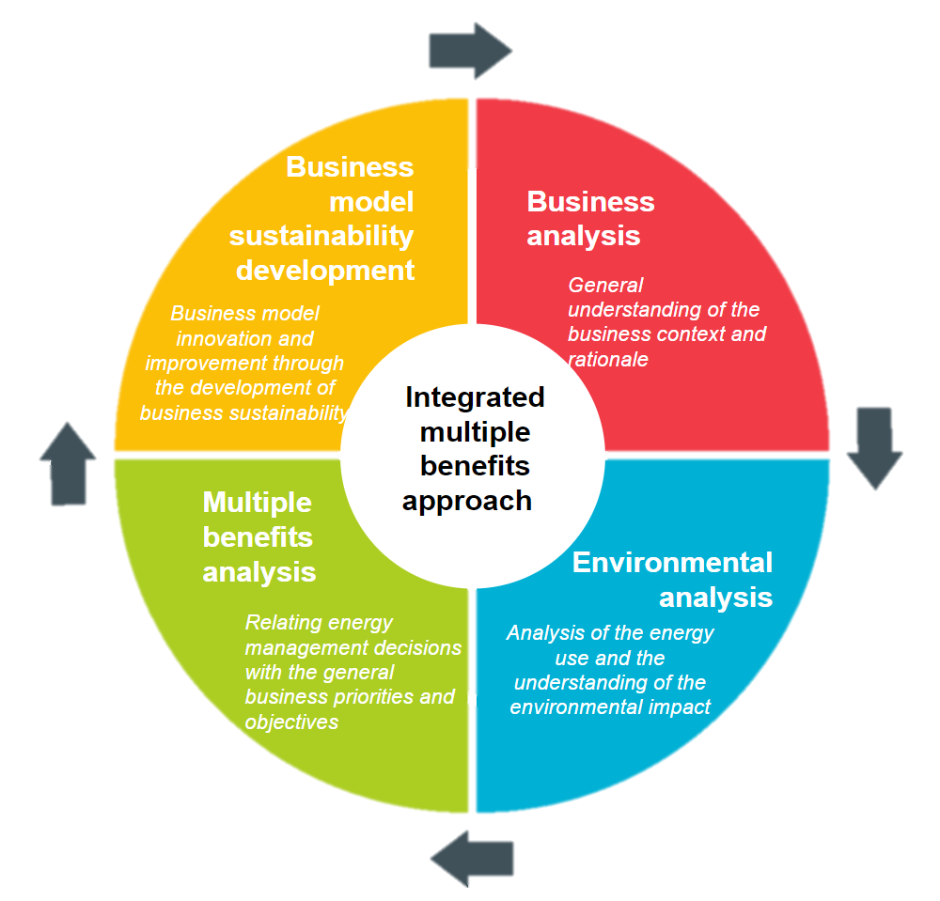
Enabling companies to enhance the impact of energy audits and energy management
companies
DEESME audit approach
Holistic DEESME approach for energy audits – especially targeted at SMEs and tailored towards the needs of companies
EMS supporting the multiple benefits approach
Creation of training documents and conduction of trainings
Conducting energy audits and implementing EMS
Bulgaria
Germany
Italy
Poland
500 companies
50 companies DEESME audit
Basic Trainings
Advanced Trainings
25 companies DEESME EMS

Slide 7
Enabling National Authorities to enhance the Impact of Energy Audits and EMS
national authorities
Identification of Challenges
Reports available at https://www.deesme.eu/knowledge-hub/

Slide 8
Enabling National Authorities to enhance the Impact of Energy Audits and EMS
national authorities
1
2
3
4
5
6
Identification of Challenges
non-SMEs
Limited resources for transposition
Identification of obligated companies
Ensuring compliance
Quality of audits
Compromise between reporting and monitoring
Enhancing the uptake of measures
11 challenges
27 sub-challenges
7
8
9
10
11
SMEs
Creation of support mechanisms
Limited available resources
Guiding SMEs to action
Raising awareness on opportunities
Non-energy
benefits
Reports available at https://www.deesme.eu/knowledge-hub/

Slide 9
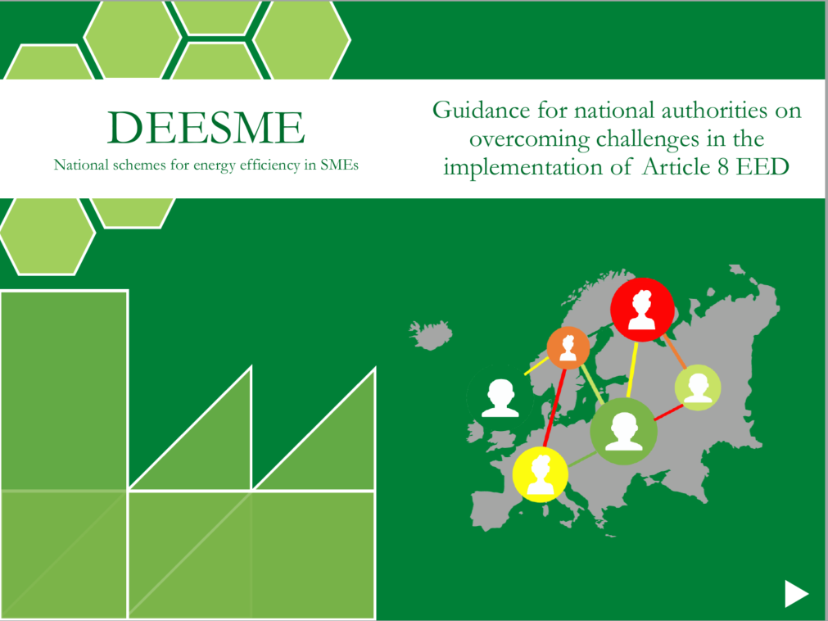
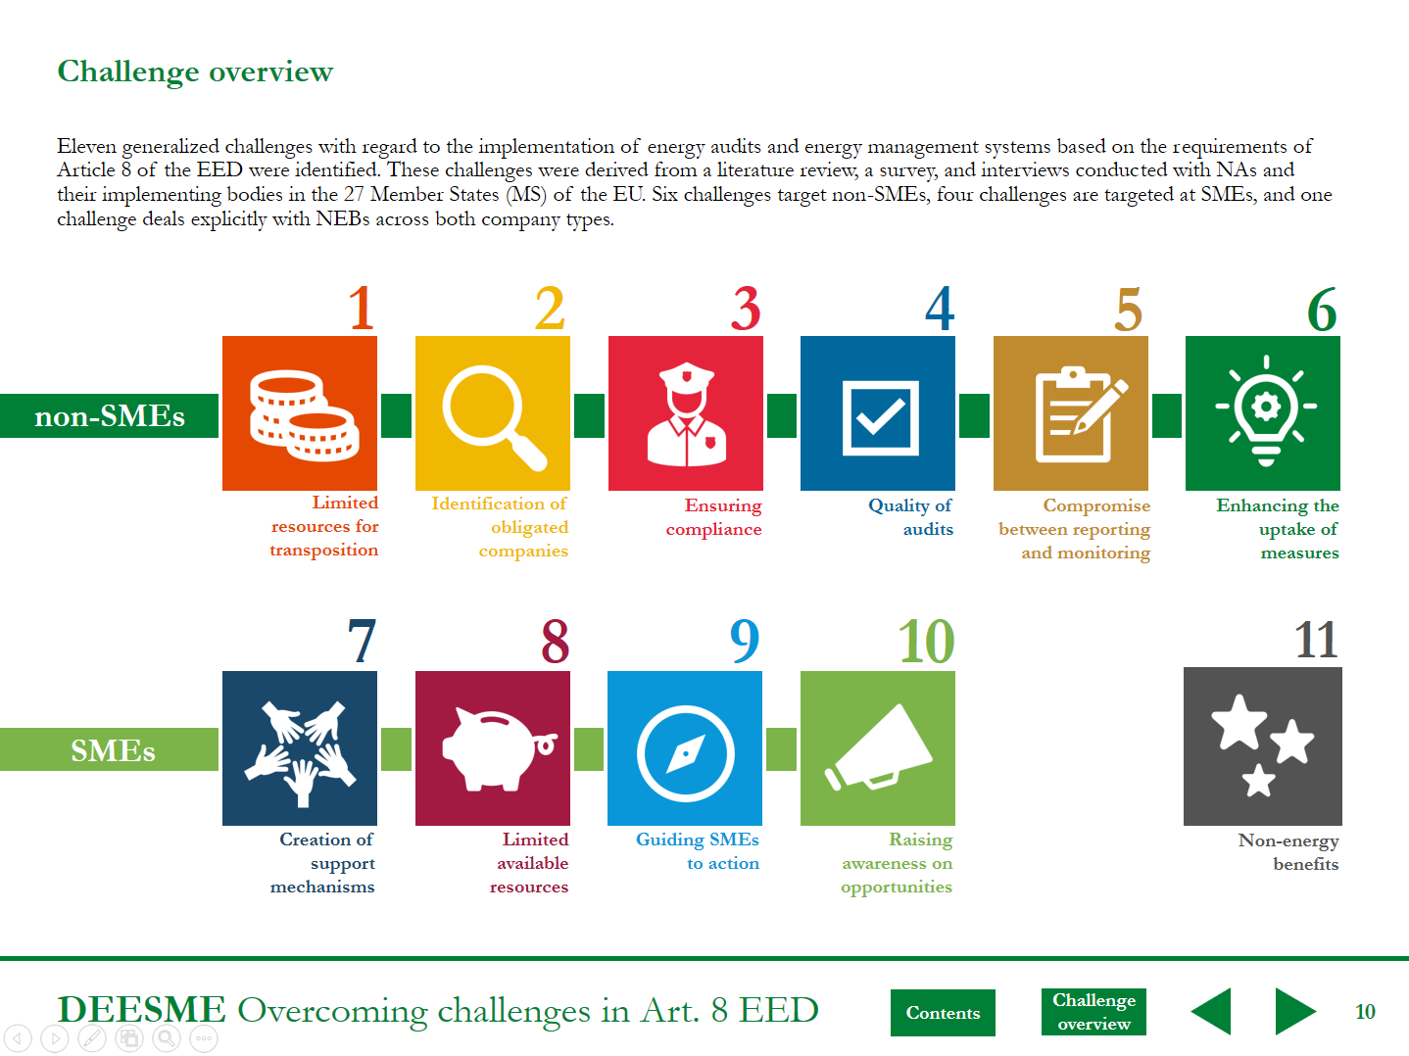
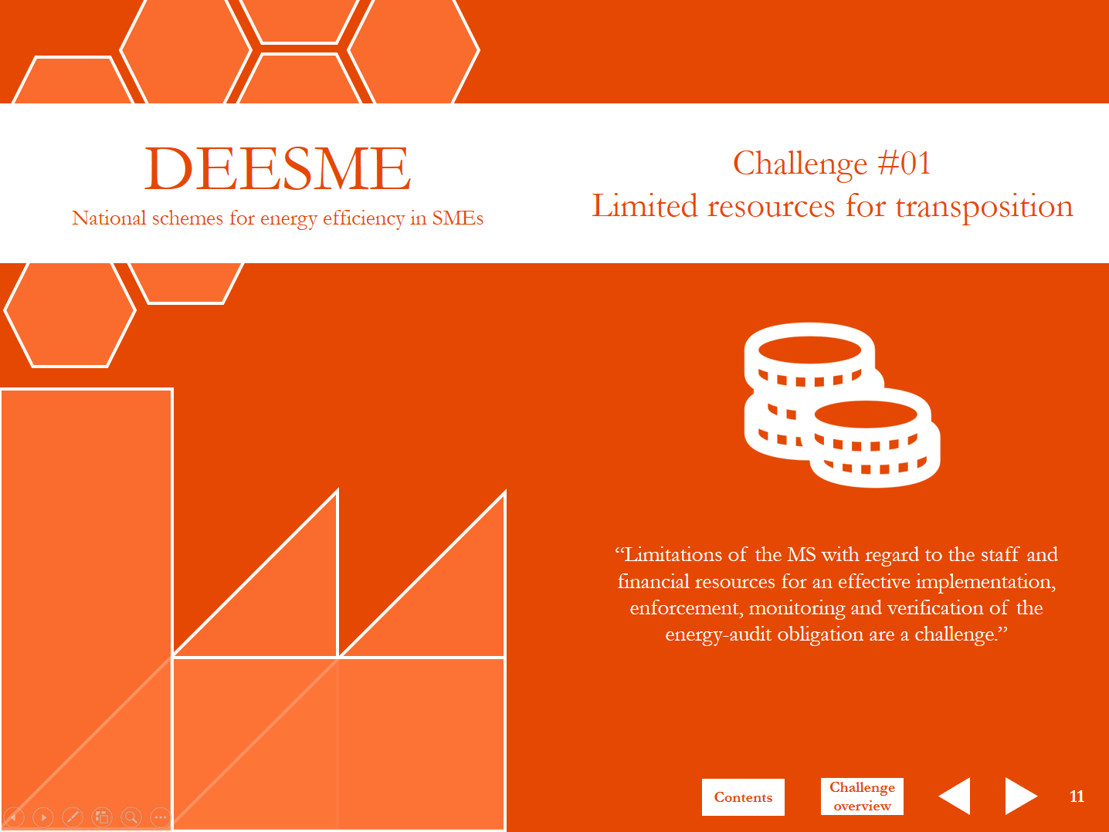
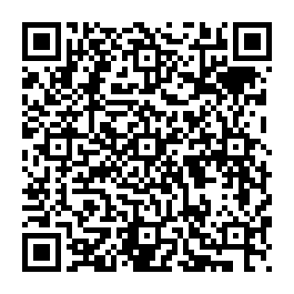
Enabling National Authorities to enhance the Impact of Energy Audits and EMS
national authorities
Identification of Challenges Best practises
55 solution strategies
50 country best practises
Interactive PDF document
Link to guideline →
Reports available at https://www.deesme.eu/knowledge-hub/

Slide 10
Challenges in transposition of Art. 8 EED
national authorities
1
2
3
4
5
6
non-SMEs
Limited resources for transposition
Identification of obligated companies
Ensuring compliance
Quality of audits
Compromise between reporting and monitoring
Enhancing the uptake of measures
7
8
9
10
11
SMEs
Creation of support mechanisms
Limited available resources
Guiding SMEs to action
Raising awareness on opportunities
Non-energy
benefits

Slide 11
Challenges in transposition of Art. 8 EED
national authorities
1
2
3
4
5
6
non-SMEs
Limited resources for transposition
Identification of obligated companies
Ensuring compliance
Quality of audits
Compromise between reporting and monitoring
Enhancing the uptake of measures
7
8
9
10
11
SMEs
Creation of support mechanisms
Limited available resources
Guiding SMEs to action
Raising awareness on opportunities
Non-energy
benefits

Slide 12
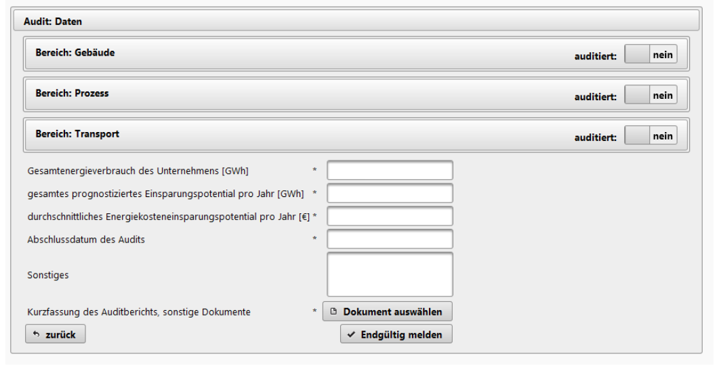
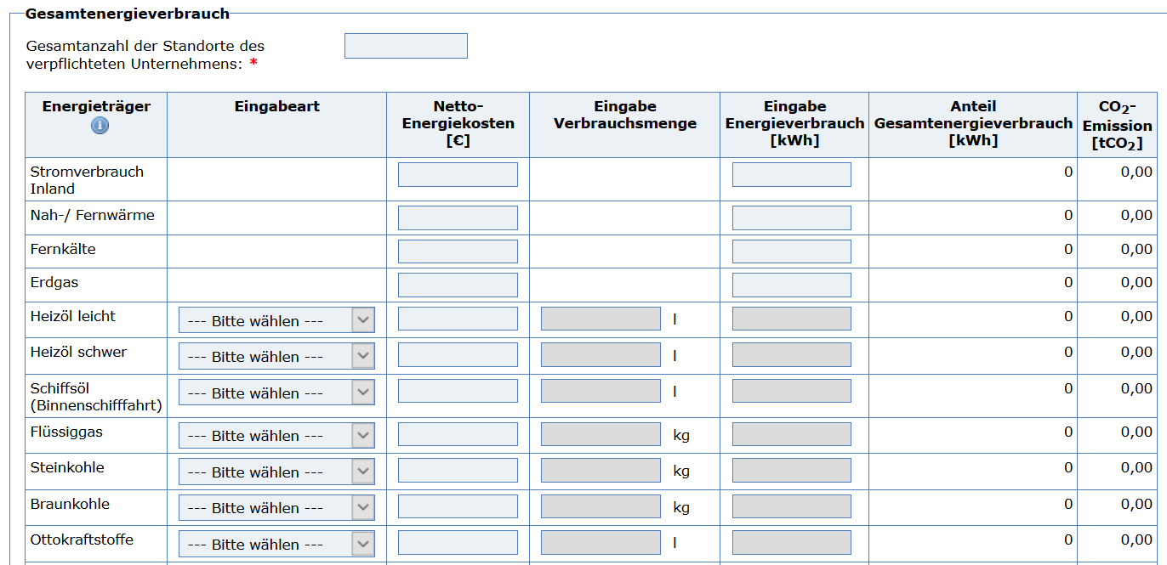
1
Limited resources for transposition
Costs for NAs due to the transposition of Article 8 of the EED can generally include initialization and reoccurring costs and effort. There tends to be a trade-off between both types of costs that, among others, depends on country-specific factors such as the number of obligated companies.
Reducing reoccurring costs by
automating the audit submission process
In Austria, companies or auditors have to report the fulfilment of the audit obligation via the business service portal (USP). The USP comprises over 50 E-government services. For the energy audit obligation, a dedicated section was included in the USP called “Application to the Energy Efficiency Act”. Access to this section is granted by the national monitoring agency.
Businessplatform Austria (USP)
Online form Germany
Business service portal Austria
https://www.usp.gv.at/
https://fms.bafa.de/BafaFrame/orea

Slide 13
Challenges in transposition of Art. 8 EED
national authorities
1
2
3
4
5
6
non-SMEs
Limited resources for transposition
Identification of obligated companies
Ensuring compliance
Quality of audits
Compromise between reporting and monitoring
Enhancing the uptake of measures
7
8
9
10
11
SMEs
Creation of support mechanisms
Limited available resources
Guiding SMEs to action
Raising awareness on opportunities
Non-energy
benefits

Slide 14
Challenges in transposition of Art. 8 EED
national authorities
1
2
3
4
5
6
non-SMEs
Limited resources for transposition
Identification of obligated companies
Ensuring compliance
Quality of audits
Compromise between reporting and monitoring
Enhancing the uptake of measures
7
8
9
10
11
SMEs
Creation of support mechanisms
Limited available resources
Guiding SMEs to action
Raising awareness on opportunities
Non-energy
benefits

Slide 15
4
Quality of audits
Factors with influence on the quality of energy audits include the qualification of auditors, the requirements to both content and structure of the audit reports as well as the regularity and depth of audit quality checks.
Quality of auditors | Clarity of procedure | Quality control of reports
Requirements for certification
Auditor specialization
List with certified auditors
European cooperation
Legal requirements
Guidelines
Templates
Basic validation
Spot checks of quality
Subcontracting

Slide 16
4
Quality of audits
Factors with influence on the quality of energy audits include the qualification of auditors, the requirements to both content and structure of the audit reports as well as the regularity and depth of audit quality checks.
Ensuring up-to-date qualification by requiring auditors to do regular trainings
In Germany, requirements were recently updated and auditors are now obligated to participate in regular trainings, on which they have to inform the national agency BAFA (EDL-G Article 8). It is expected that auditors will have to complete 16 units of training (each 45 minutes) with relevance to energy audits every 2 years.
Improving audits by providing a detailed guideline on how to conduct audits
Ireland created an elaborate 64 page interactive PDF document that guides auditors and companies step by step through the process of conducting the energy audit and reporting the results.
SEAI Energy Audit Handbook
Defined in draft legislation

Slide 17
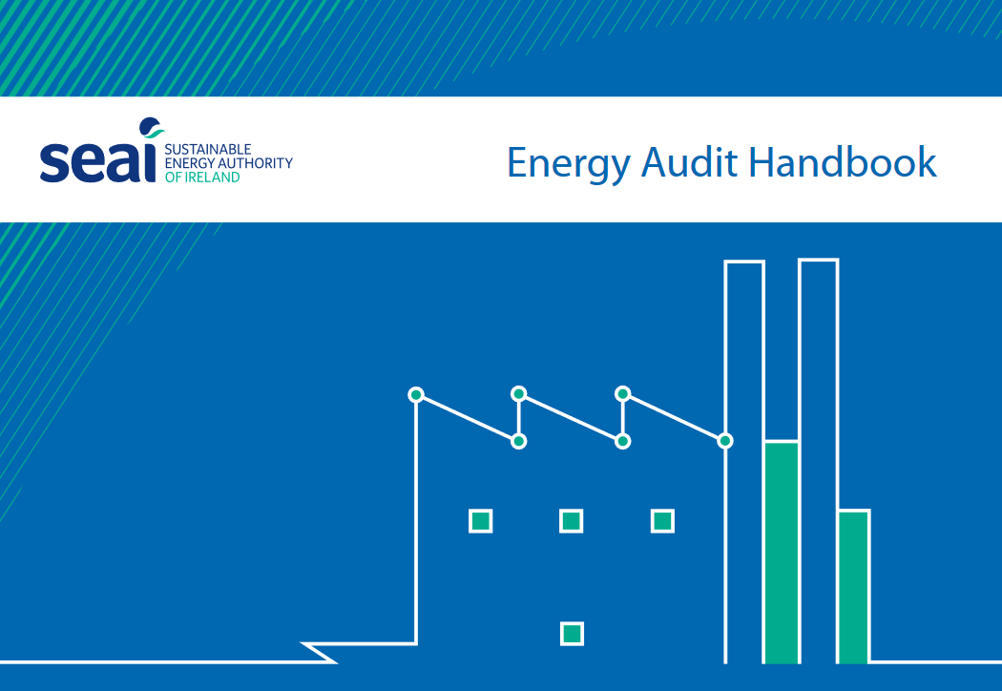
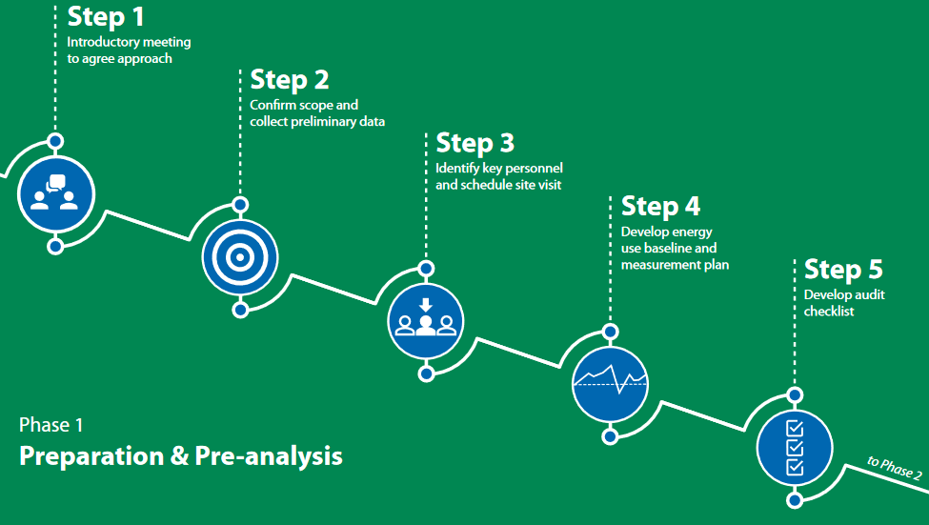
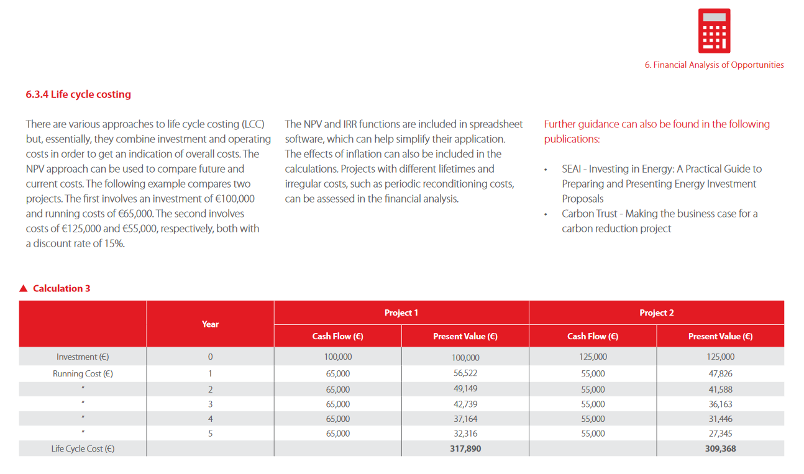
4
Quality of audits
Factors with influence on the quality of energy audits include the qualification of auditors, the requirements to both content and structure of the audit reports as well as the regularity and depth of audit quality checks.
https://www.seai.ie/publications/SEAI-Energy-Audit-Handbook.pdf

Slide 18
Challenges in transposition of Art. 8 EED
national authorities
1
2
3
4
5
6
non-SMEs
Limited resources for transposition
Identification of obligated companies
Ensuring compliance
Quality of audits
Compromise between reporting and monitoring
Enhancing the uptake of measures
7
8
9
10
11
SMEs
Creation of support mechanisms
Limited available resources
Guiding SMEs to action
Raising awareness on opportunities
Non-energy
benefits

Slide 19
Challenges in transposition of Art. 8 EED
national authorities
1
2
3
4
5
6
non-SMEs
Limited resources for transposition
Identification of obligated companies
Ensuring compliance
Quality of audits
Compromise between reporting and monitoring
Enhancing the uptake of measures
7
8
9
10
11
SMEs
Creation of support mechanisms
Limited available resources
Guiding SMEs to action
Raising awareness on opportunities
Non-energy
benefits

Slide 20
6
Enhancing the uptake of measures
There are various support mechanisms to encourage companies to improve energy efficiency, either based on obligations, financial incentives or informational instruments.
Obligation of implementation | Financial incentives | Information
For energy intensive companies: At least one measure All cost-effective measures | Funding Grants Tax reliefs | Homepage or tool informing about financial schemes Campaigns, workshops... Hotline
Funding and grand in most of the MS
Minority of MS

Slide 21
6
Enhancing the uptake of measures
There are various support mechanisms to encourage companies to improve energy efficiency, either based on informational instruments, financial incentives or obligations.
Dutch Activities Decree
Contains environmental regulations
Applicable to all companies in the Netherlands, unless they have little or no impact on the environment
Many of the rules are detailed in the Activities Regulations
Environmental Management Activities Degree
Section 2.6. Energy saving
Article 2.15 Energy-saving measures
https://rwsenvironment.eu/subjects/environmental-0/activities-decree/

Slide 22
6
Enhancing the uptake of measures
There are various support mechanisms to encourage companies to improve energy efficiency, either based on informational instruments, financial incentives or obligations.
Improve industrial energy efficiency by using energy thresholds to mandate companies to implement measures
Under the Environmental Management Activities Decree, the Netherlands obliges companies which consume more than 50 000 kWh of electricity or 25 000 m³ of natural gas to take energy-saving measures with a payback period of 5 years or less. The regulation was implemented independent from the energy audit obligation.
Environmental Management Activities Decree
Article 2.15
(1) [...] takes all energy-saving measures with a payback of five years or less.
→ (5) [...] not being complied with, [...] oblige [...] to carry out investigation.
(2) [...] report to the competent authority no later than 1 July 2019 and thereafter once every four years what energy-saving measures have been taken.
Website of the Dutch NA
https://wetten-overheid-nl.translate.goog/BWBR0022762/2022-09-21/?_x_tr_sl=nl&_x_tr_tl=en&_x_tr_hl=de&_x_tr_pto=wapp#Hoofdstuk2_Afdeling2.6_Artikel2.15

Slide 23
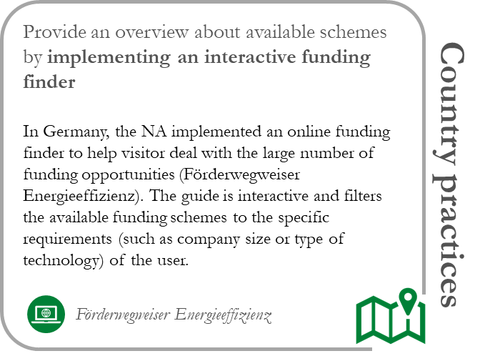
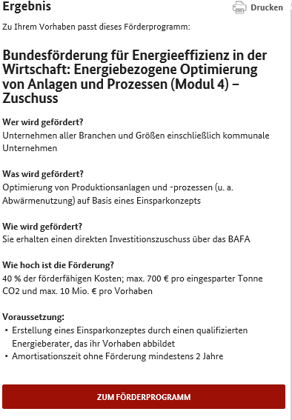
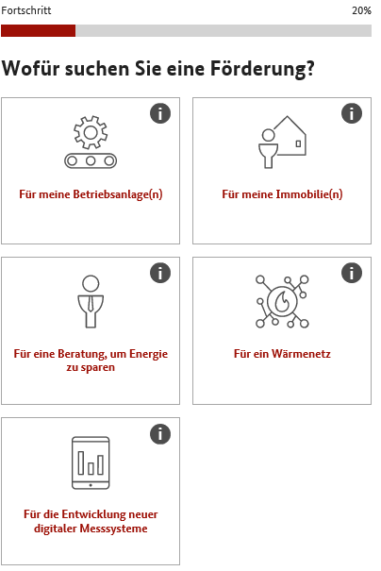
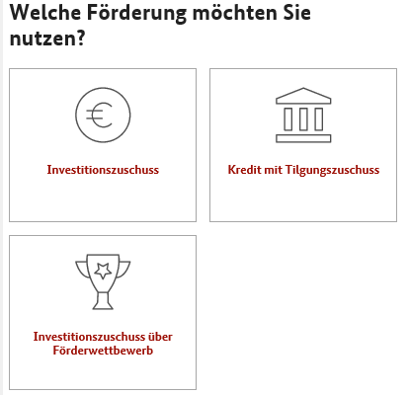
6
Enhancing the uptake of measures
There are various support mechanisms to encourage companies to improve energy efficiency, either based on informational instruments, financial incentives or obligations.
4. Matching funding
1. SME or not?
2. What for?
3. Type of funding?

Slide 24
Information about Art. 8 EED recast
25.10.2012 Directive 2012/27/EU on energy efficiency
2013 & 2018 & 2019 Amendments but with no changes to Art. 8
14.07.2021 Proposal for a Directive on energy efficiency (recast)
Link to EED: https://eur-lex.europa.eu/legal-content/EN/TXT/PDF/?uri=CELEX:02012L0027-20200101&from=EN

Slide 25
Information about Art. 8 EED recast
No more SME / non-SME distinction
Company category | Staff headcount | Turnover or | Balance sheet total
SME | <250 | <= € 50 m | <= € 43 m
Art. 8 Art. 11: Energy management systems and energy audits
[...] enterprises with an average annual (energy) consumption higher than
100 TJ → implement EMS
10 TJ → subject to energy audit
[...] results of energy audits including the recommendations [...] must be transmitted to the management.
[...] ensure that quality checks are carried out to ensure the validity and accuracy of energy audits.
Higher implementation rate by involving management?
Higher quality audits?
25.10.2012 Directive 2012/27/EU on energy efficiency
2013 & 2018 & 2019 Amendments but with no changes to Art. 8
14.07.2021 Proposal for a Directive on energy efficiency (recast)
Link to EED: https://eur-lex.europa.eu/legal-content/EN/TXT/PDF/?uri=CELEX:02012L0027-20200101&from=EN

Slide 26
Individual countries going beyond...
Netherlands
Germany
Environmental Management Activities Decree
Article 2.15
(1) [...] takes all energy-saving measures with a payback of five years or less.
→ (5) [...] not being complied with, [...] oblige [...] to carry out investigation.
(2) [...] report to the competent authority no later than 1 July 2019 and thereafter once every four years what energy-saving measures have been taken.
New ordinance since September 2022
https://wetten-overheid-nl.translate.goog/BWBR0022762/2022-09-21/?_x_tr_sl=nl&_x_tr_tl=en&_x_tr_hl=de&_x_tr_pto=wapp#Hoofdstuk2_Afdeling2.6_Artikel2.15

Slide 27
Mittelfristenergieversorgungssicherungsmaßnahmenverordnung (we all love the German language ;-) )
October 2022
2 year validity
October 2024
Medium-Term Energy Supply Security Measures Ordinance from 23 September 2022
§4 Implementation of economic energy efficiency measures in enterprises
Enterprises shall be obliged to implement [...] all measures specifically identified and assessed as economically feasible in order to improve the energy efficiency of their enterprise without delay. These measures shall be implemented within 18 months at the latest. A measure shall be deemed to be economically feasible if the economic assessment of the measure according to DIN EN 17463, December 2021 edition, results in a positive net present value after a maximum of 20 percent of the useful life, but limited to an assessment period of a maximum of 15 years.
Enterprises shall be obliged to have certifiers, environmental auditors or energy auditors confirm the measures implemented pursuant to subsection (1) which were not implemented due to their lack of economic viability.
The obligations to implement measures pursuant to subsections (1) and (2) shall not apply to installations requiring a permit pursuant to section 4 of the Federal Immission Control Act, insofar as these installations are subject to more specific requirements for the implementation of energy efficiency measures.
Furthermore, the obligations to implement measures pursuant to subsections (1) and (2) shall not apply to undertakings whose total energy consumption within the last three years amounted to less than 10 gigawatt hours per year on average.
Norm: DIN EN 17463:2021-12 Valuation of Energy Related Investments
Potential conflict of interest: company pays auditor – auditor decides which measures have to be implemented
Exemption for small consumers
EnSimiMaV - Verordnung zur Sicherung der Energieversorgung über mittelfristig wirksame Maßnahmen (gesetze-im-internet.de)

Slide 28
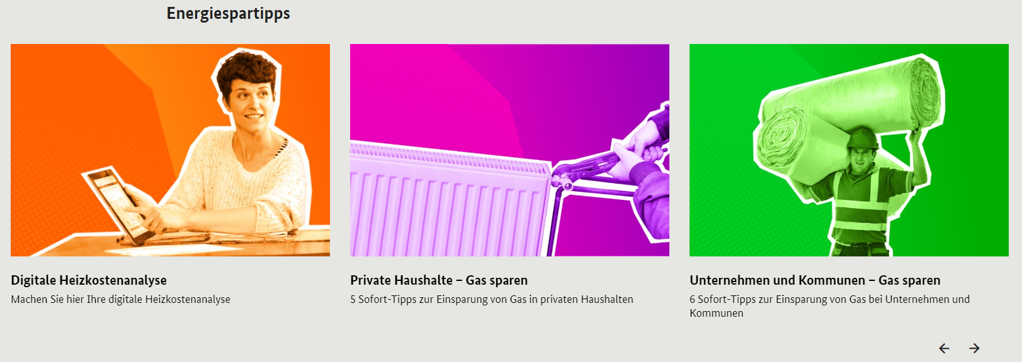
Accompanying energy saving campaign
80 Millionen gemeinsam für Energie sparen - 80 million together for energy saving
Private households
Companies
Short, hands-on tips for immediate energy saving in a variety of areas
Modern Lighting with LEDs
Optimize air conditioning and sun coverage
Exchange old devices against energy efficient one’s
Renew ventilation system
Utilize excess heat
BMWK - Energieeffizienzeinsparungen für Unternehmen (energiewechsel.de)

Slide 29
Thank you for your attention
Follow us and subscribe to our newsletter not to miss any news!
www.deesme.eu
@DeesmeH2020
@DEESME H2020

